Slide 1

Spotify Song
Lydia Akalu

Slide 2
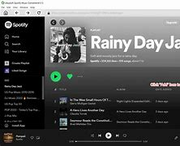
Introduction to the Dataset:
Spotify is one of the largest music streaming platforms globally, making this dataset highly relevant for understanding modern music consumption
The dataset consists of songs from Spotify, which includes various features such as tempo, energy, danceability, loudness, and more. This dataset is particularly interesting because it allows to explore trends in music preferences, the characteristics of popular songs, and how various audio features correlate with each other.

Slide 3
The dataset contains various features for Spotify songs, including:
Artist: Name of the artist
Song: Title of the song
Duration (ms): Song duration in milliseconds
Explicit: Whether the song has explicit content (True/False)
Year: Release year
Popularity: Popularity score of the song
Danceability: How suitable a track is for dancing (0-1 scale)
Energy: Intensity of the song (0-1 scale)
Key: Key of the song (pitch class)
Loudness: Overall loudness in decibels (dB) mostly negative values
Mode: Modality (major=1, minor=0)
Speechiness: Spoken word proportion in the song
Acousticness: Probability of being acoustic (0-1 scale)
Instrumentalness: Probability of being instrumental
Liveness: How likely it is recorded live
Valence: Musical positiveness (0-1 scale)
Tempo: Beats per minute (BPM)
Genre: Song genre(s)

Slide 4
Reason for Choosing the Dataset: Spotify is one of the largest music streaming platforms globally, making this dataset highly relevant for understanding modern music consumption

Slide 5
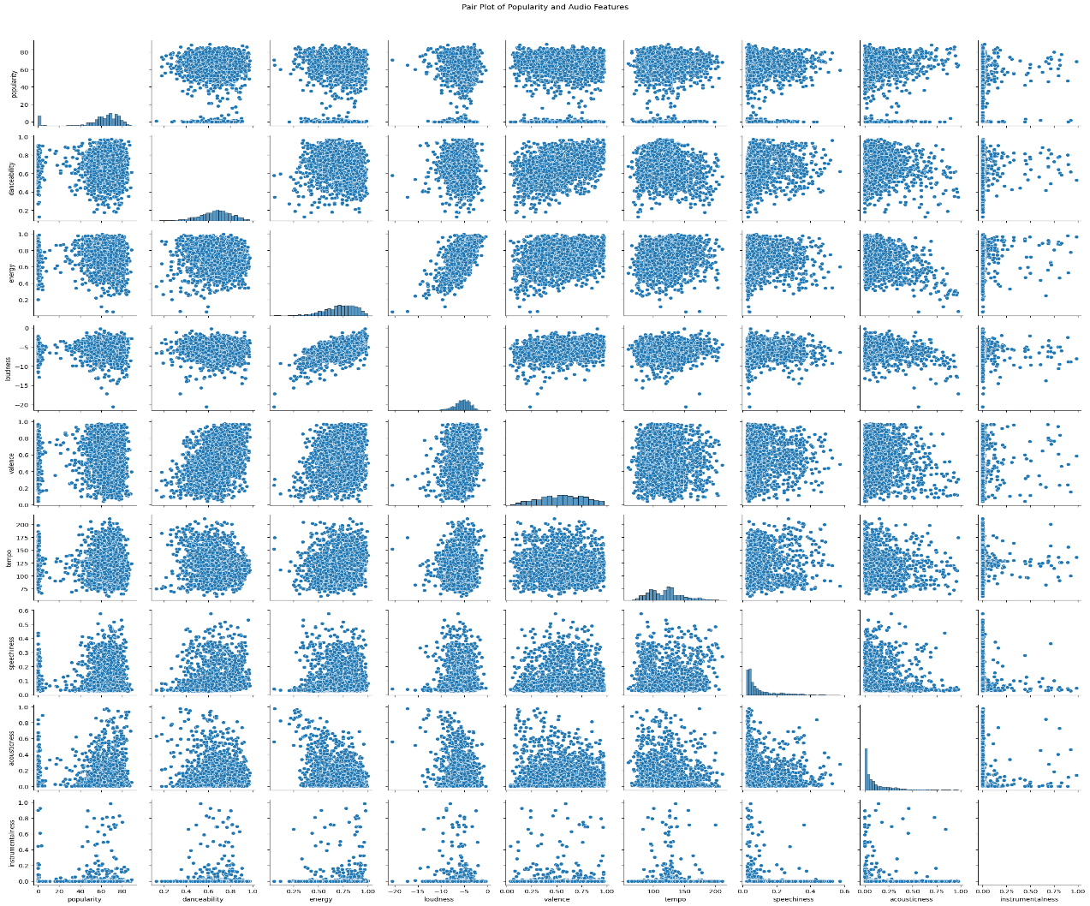
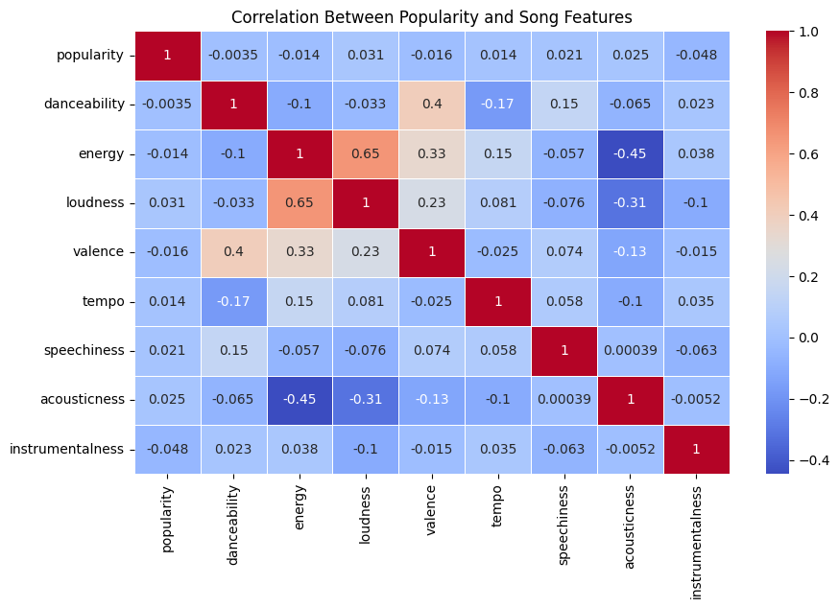
Correlation between popularity and song features
We can use different methods to analyze the correlation of each feature. Which in our case heatmap is more useful.

Slide 6
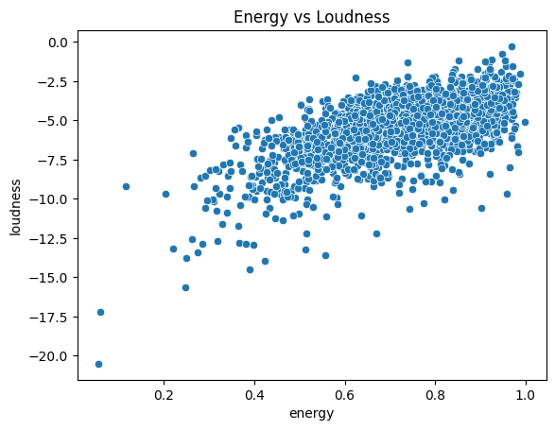
Energy vs. Loudness
There is a noticeable positive correlation between energy and loudness. As energy increases, so does loudness. This suggests that songs with higher energy levels tend to be louder.

Slide 7
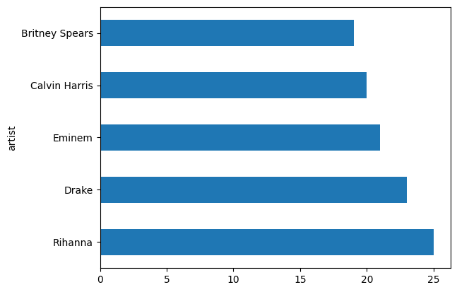
Top five popular Artists

Slide 8
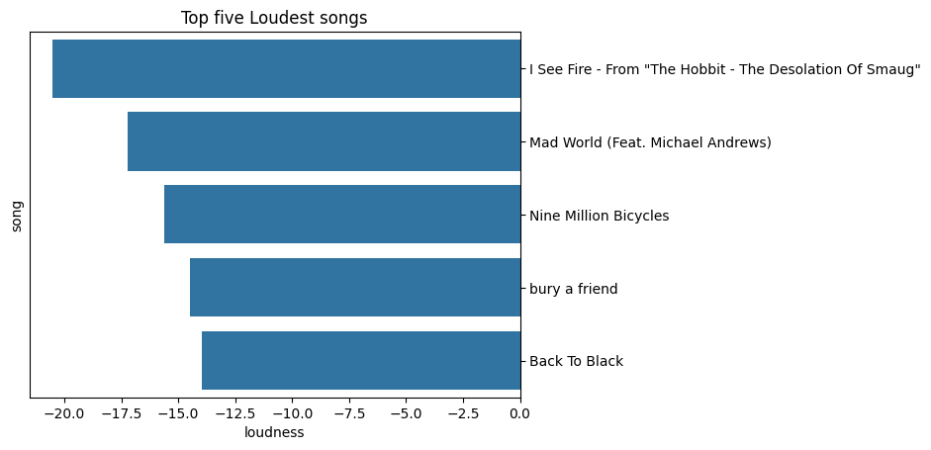
Top five Loudest songs
For example, a song with a loudness of -4 dB is louder than one with -10 dB.
Loudness is Loudness in audio analysis is measured in decibels (dB), which is a logarithmic unit used to express the intensity of sound. For example, a song with a loudness of -4 is louder than one with -10. In this graph back to black is the loudest song.( the graph is plotted in acceding order)

Slide 9
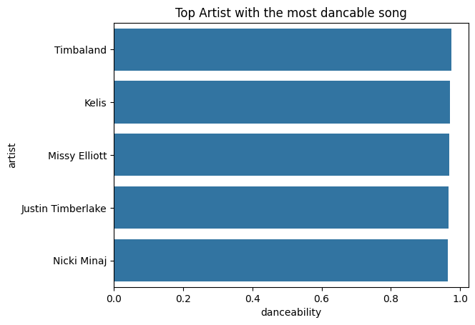
Top five artist with the most danceable songs

Slide 10
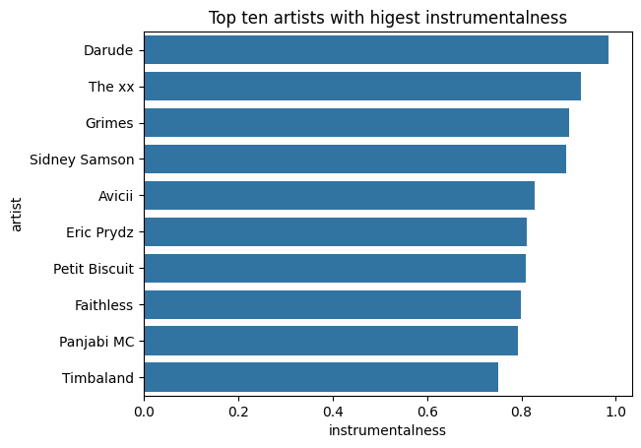
Top Ten artist with the highest instrumental songs

Slide 11
Thank you

